Slide 1
Concept similarity in Formal Concept Analysis: An information content approach
Anna Formica

Slide 2
Abstract
Concept similarity allows the identification of different concepts that are semantically close.
Determine the similarity of concept descriptors (attributes) by using the information content approach, rather than relying on human domain expertise.
a higher correlation with human judgment.

Slide 3
1. Introduction
Support the user in analyzing and structuring a domain of interest.
Given a domain, a concept in FCA is a pair of sets: a set of objects, which are the instances of the concept in that domain, and a set of attributes, which are the descriptors of the concept.
Semantic Web, ontology engineering.
human interaction, time-consuming and error-prone.
The domain expert knowledge.
Similarity degrees for any pair of concept descriptors
Similarity Graph

Slide 4
Information content, automatically obtain attribute similarity scores without relying on human domain expertise.
Compute attribute similarity by using the noun frequencies that are defined in any lexical database for the English language, such as WordNet.
Comparing the intensional components of FCA concepts according to a method that overcomes the limitations of Dice’s function

Slide 5
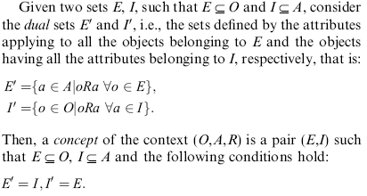
2. Formal Concept Analysis
A context is a triple (O,A,R) …

Slide 6
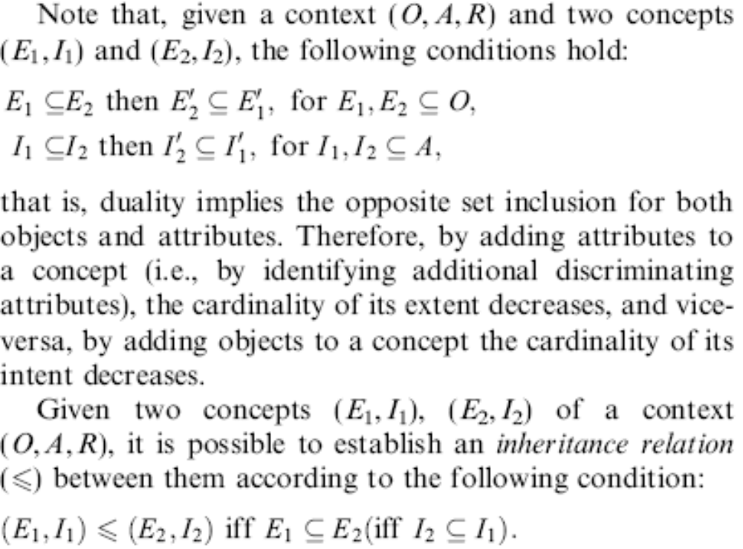

Slide 7
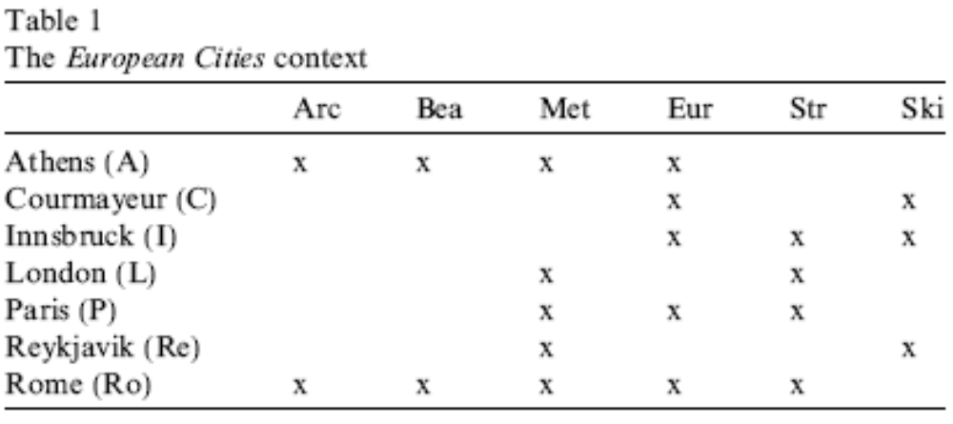

Slide 8
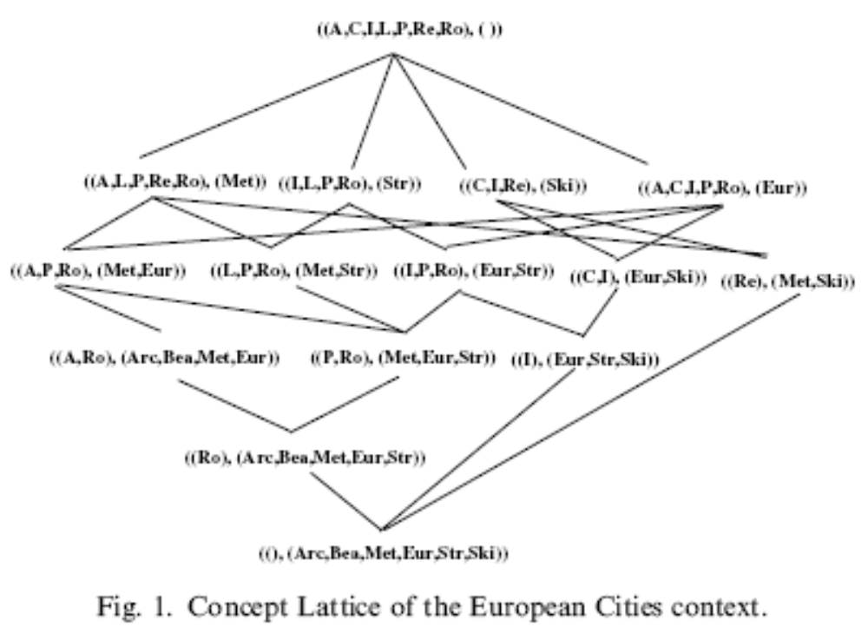

Slide 9
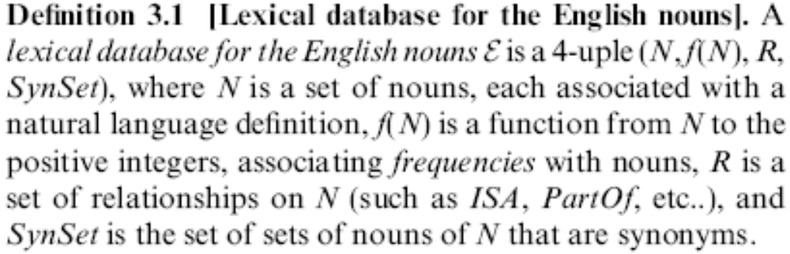
3. Information content similarity
(N, f(N), R, SynSet)

Slide 10
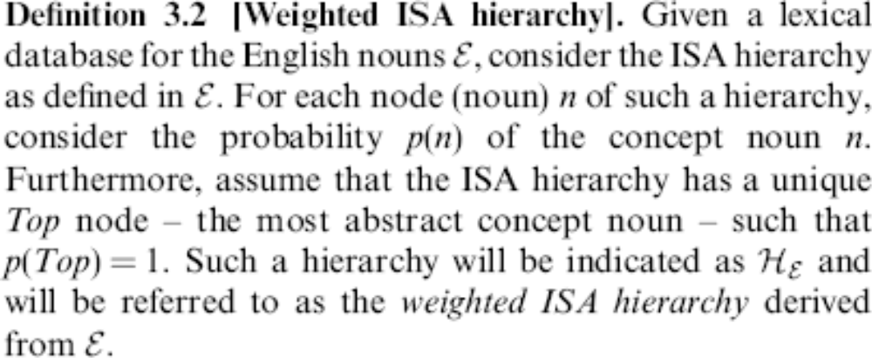
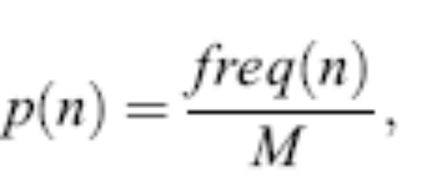
<- the frequency of n estimated using noun frequencies from large text corpora
<- the total number of observed instances of nouns in the corpus.

Slide 11
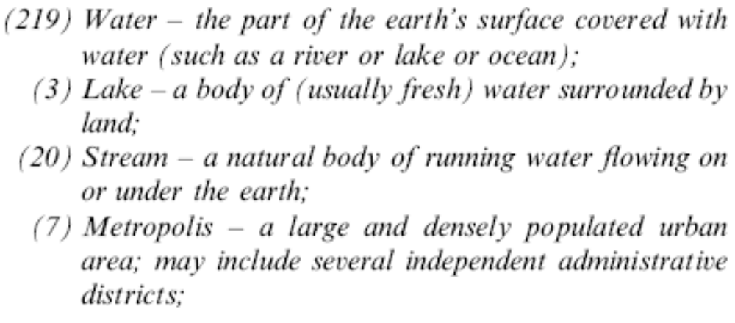
probabilities have been assigned according to the SemCor project，which labels subsections of the Brown Corpus to senses in the WordNet lexicon.

Slide 12
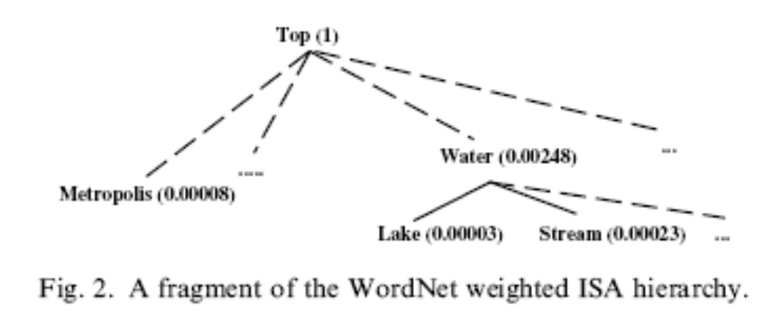
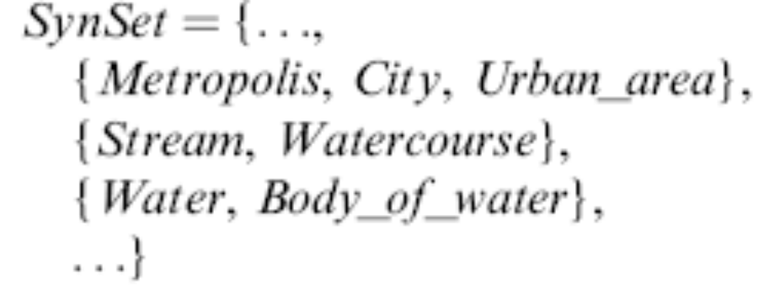
the weighted ISA hierarchy
the SynSet

Slide 13
The information content of a noun n is defined as –logp(n), that is, as the probability of a concept noun increases, the informativeness decreases, therefore the more abstract a concept noun, the lower its information content.
Water: -log(0.00248) = 8.66
Lake : -log(0.00003) = 14.85
The similarity of hierarchically organized concept nouns is given by the maximum information content shared by the nouns, that is, the more information two nouns share, the more similar they are.

Slide 14
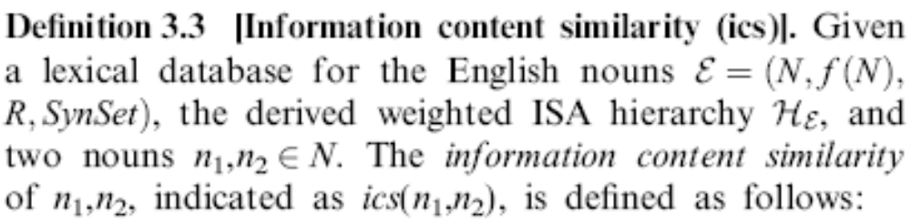
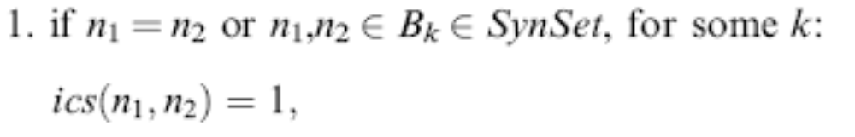

Slide 15
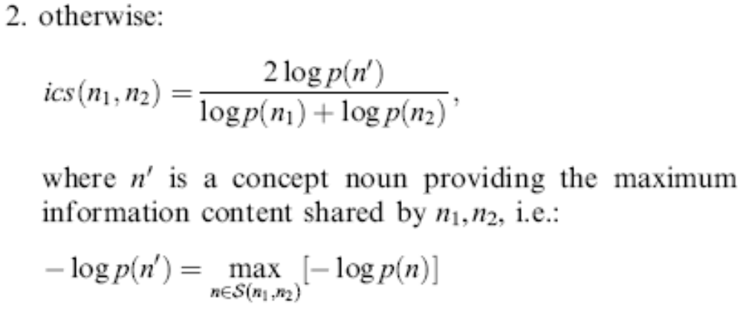
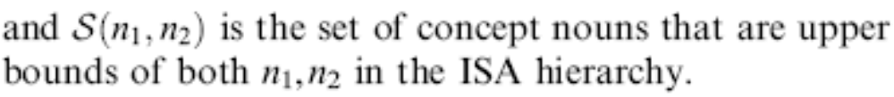

Slide 16
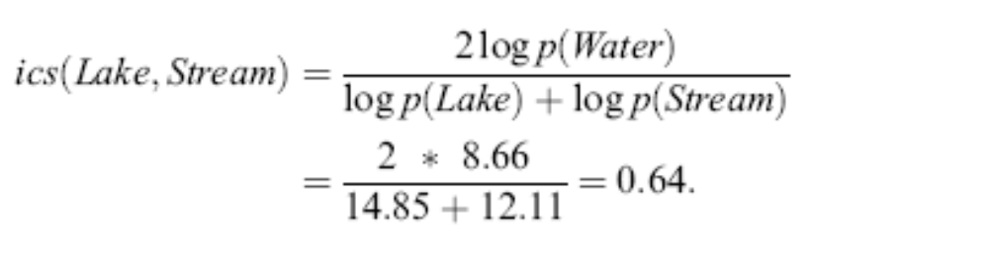

Slide 17

4. Similarity between FCA concepts
Consider a lexical database for the English nouns , and two concepts (E₁, I₁) and (E₂, I₂) not necessarily belonging to the same context.
Let a candidate set of pairs be a subset of I₁ X I₂ such that there are no two pairs in the set sharing an element.
Then, within all possible candidate sets of pairs, consider the set such that the sum of the ics of the pairs of attributes is maximal. Such a sum will be indicated as M(I₁, I₂).
The maximum weighted matching

Slide 18
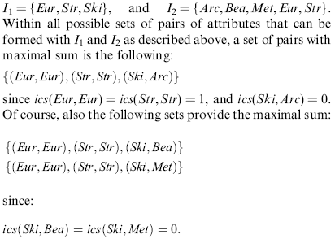

Slide 19
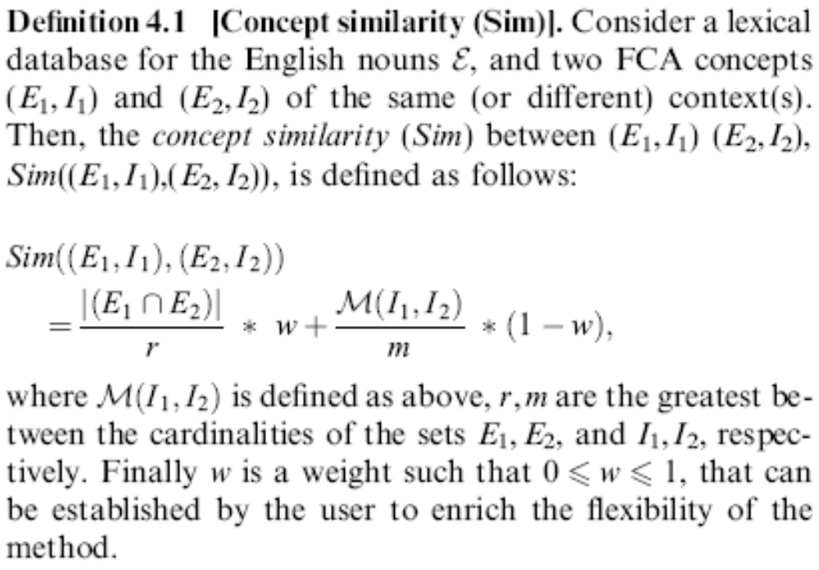

Slide 20
(I,Kla),(Lak,Eur,Ski))

Slide 21
5. Related work
Fuzzy Concept Lattices, for the modeling of vague extents and intents of concepts.
The large number of concepts, by using factorization of Concept Lattices.
Similarity of concept intents is computed independently of the related extents.
……

Slide 22
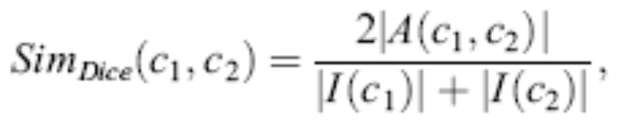
6. Evaluation of the method
without relying on human domain expertise.
the information content similarity (ics).
the entire intensional components of FCA concepts, i.e., their sets of attributes.
the Dice’s function

Slide 23
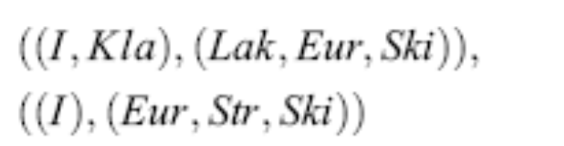
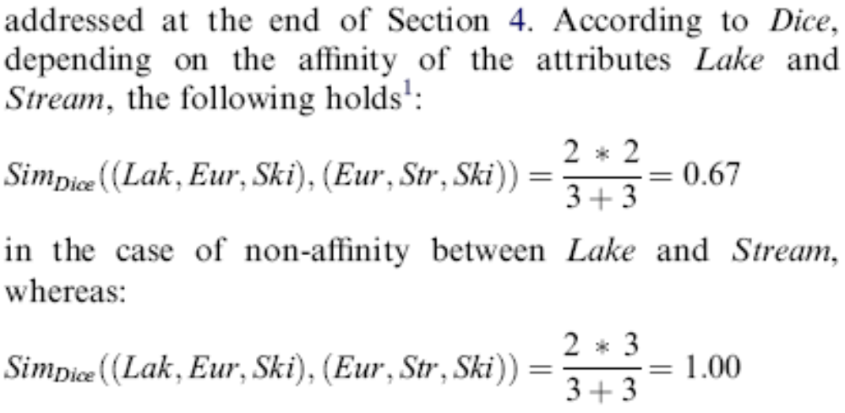


Slide 24
7. Conclusion
Lexical datebase ← WordNet
Weighted ISA hierarchy ← Frequency Analysis
Ics ← 属性间语义相似度量
Concept similarity (Sim) ← the maximum weighted matching problem

Slide 25
Thanks for your attention!

